Slide 1


DATABASE SYSTEMS ENGINEERING AND DISTRIBUTED BACKEND DEVELOPMENT (25CS1302E)
Project Review 1
Project Title: Skill Exchange & Micro-Learning Platform
CAPACITY CONNECT
A Peer-to-Peer Skill Sharing Platform
Presented by:
Marri Hruthika - 2520090002
K.Gyathri Srivalli - 2520080010
A.Yuktha - 2520090093

Slide 2
ABSTRACT
CapacityConnect is a peer-to-peer skill-sharing platform developed to bridge the gap between individuals who possess valuable skills and those who are looking to acquire new skills. In traditional learning environments, users often depend on formal courses, instructors, or scattered online resources, while many individuals have practical knowledge that remains underutilized. CapacityConnect provides a structured platform where users can showcase the skills they can offer, identify the skills they want to learn, discover suitable peers, and exchange knowledge. The system promotes two-way learning, allowing a user to be both a learner and a skill provider. By connecting people based on their skills and learning interests, CapacityConnect encourages collaboration, knowledge sharing, and continuous personal development. The proposed platform aims to make learning more accessible, interactive, community-driven, and mutually beneficial.

Slide 3
PROBLEM STATEMENT
In today’s learning environment, many individuals possess valuable skills and practical knowledge, while others are looking for opportunities to learn those skills. However, there is no simple and structured platform that effectively connects skill providers with skill seekers based on their specific interests. Existing learning platforms generally follow a one-way learning model, while social platforms are not specifically designed for skill-based connections.
This creates a gap between people who have skills to share and those who want to learn them, resulting in:
  Difficulty finding the right person for a specific skill
  Limited opportunities for peer-to-peer knowledge exchange
  Valuable skills remaining underutilized or undiscovered
  Lack of a centralized platform for skill discovery and connection
  Limited scope for mutual learning, where users can both teach and learn
Therefore, a structured platform is needed to make skill sharing more accessible, collaborative, and mutually beneficial.

Slide 4
EXISTING SYSTEM
Currently, people use different platforms and methods to learn or share skills, but these approaches have several limitations.
  Online Learning Platforms: Provide structured courses, but mostly follow a one-way learning model.
  Video Tutorials: Offer easy access to knowledge but provide limited personal interaction.
  Social Media Platforms: Allow people to connect, but they are not specifically designed for skill-based matching.
  Personal Networks: Skill sharing depends on friends, classmates, or known contacts, which limits the reach.
  Workshops & Training Programs: Can provide interaction but may involve time, location, and cost constraints.
Major Limitation:
Existing solutions provide learning or social networking separately, but lack a dedicated system focused on connecting people for mutual skill sharing.

Slide 5
PROPOSED SOLUTION — CapacityConnect
CapacityConnect proposes a centralized peer-to-peer skill-sharing platform that connects users based on the skills they can offer and the skills they want to learn. Instead of limiting users to one-way learning, the platform enables mutual knowledge exchange, allowing every user to become both a learner and a skill provider.
How CapacityConnect Solves the Problem:
  Users create a profile and list the skills they can offer.
  Users specify the skills they want to learn.
  The system helps users discover relevant skill providers and learners.
  Users can connect with suitable peers based on their interests.
  Knowledge is exchanged through peer-to-peer interaction and collaboration.
  The platform creates a community where users can learn, share, and grow together.

Slide 6
KEY FEATURES OF CapacityConnect
  User Profile — Create a profile with personal details, skills, and learning interests.
  Skill Listing — Users can add the skills they can teach or share.
  Learning Interests — Users can specify the skills they want to learn.
  Skill Discovery — Explore different skills and find relevant people.
  Skill Matching — Identify potential connections based on offered and required skills.
  Peer Connection — Connect with suitable users for knowledge exchange.
  Two-Way Learning — Users can be both learners and skill providers.
  Collaborative Learning — Encourage communication, knowledge sharing, and continuous improvement.

Slide 7
METHODOLOGY
  CapacityConnect follows a simple workflow to connect users based on their skills offered and learning requirements.
  1. User Registration
  ↓
  2. Create Profile
  Users add their skills and learning interests.
  ↓
  3. Skill Input
  Specify Skills I Can Share + Skills I Want to Learn
  ↓
  4. Skill Matching
  The system identifies users with relevant complimentary skills.
  ↓
  5. User Discovery & Connection
  Users explore suitable profiles and connect with them.
  ↓
  6. Skill Exchange
  Users interact and share knowledge through peer-to-peer learning.
  ↓
  7. Continuous Learning
  Users gain new skills while contributing their existing knowledge.
  Register → Profile → Add Skills → Match → Connect → Exchange → Learn & Grow

Slide 8
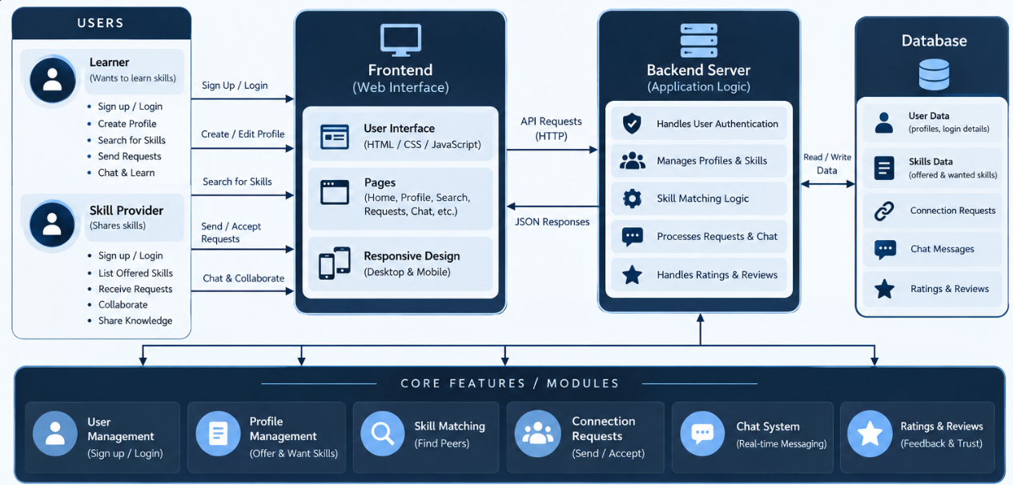
Architecture Diagram

Slide 9
CONCLUSION & FUTURE VISION
  CapacityConnect bridges the gap between skill seekers and skill providers by creating a peer-to-peer environment for discovering, sharing, and exchanging knowledge. It promotes two-way learning, allowing every user to become both a learner and a contributor.
Future Vision:
  AI-powered skill matching and personalized recommendations
  Skill verification, ratings, and reviews for trusted connections
  Integrated chat and video-based learning
  Gamification through badges and achievements
  Expansion into a mobile application
  Integration with professional and career opportunities

Slide 10
Thank You

